Slide 1
MACHINE LEARNING
Project Title: IPOVista
Team Name(s) with Registration No.: Proto (23FE10CDS00293 & 23FE10CDS00288)

Slide 2

Content
1. Introduction
->1.1 Overview, Motivation, Applications, and Domain
2.1 Problem Statement
3.1 Dataset Description
->3.2 Data Preprocessing
4.1 Machine Learning Techniques applied
5.1 Results obtained
6.1 Conclusion
7.1 References

Slide 3


1. Introduction
IPOs are crucial in modern finance, enabling companies to raise capital and providing investors with high-growth opportunities.
Predicting IPO success is challenging due to factors like market sentiment, economic trends, and company-specific attributes.
Inaccurate predictions can result in significant risks for investors in volatile markets.
With advancements in data science and machine learning, our project uses these tools to forecast IPO prices, helping investors assess profitability, reduce risks, and maximize returns.

Slide 4





1.1 Overview, Motivation, Applications, and Domain
This project aims to develop a machine learning-based application to predict IPO prices using historical data, company financials, and market sentiment, aiding investors in making informed decisions. The motivation is to fill the gap in financial prediction with a tool specifically tailored for IPOs, reducing investment risks. The app benefits financial analysts, investors, and portfolio managers by providing insights into IPO profitability, enhancing investment strategies, and enabling data-driven decisions. It operates at the intersection of data science, financial engineering, machine learning, and investment analysis.
.

Slide 5


2.1 Problem Statement
This project aims to develop a machine learning model that accurately predicts post-launch IPO prices, addressing the gap in existing models that focus on broader stock predictions. By considering key factors like macroeconomic conditions, company fundamentals, and market sentiment, the model will help investors assess potential profits and manage risks more effectively.

Slide 6

3.1 Dataset Description
The dataset used in this project is sourced from a CSV file and contains detailed information about Initial Public Offerings (IPOs) in the Indian stock market. It compiles data on various IPOs launched across different years, capturing essential financial metrics and stock performance indicators. This dataset can be used to explore trends, analyze IPO success factors, and build predictive models for IPO price movement.
The primary objective of this dataset is to assist in understanding the relationship between different financial attributes (like issue price, listing price, subscription details, etc.) and the performance of IPOs on their listing day or over time.
Target Variable (for prediction-based use cases)
Listing Gain (%): This can be used as the target for regression (predicting the gain/loss on the day of listing).
Alternatively, a binary classification can be built based on whether the listing gain is positive or not.

Slide 7
3.1 Dataset Description
Features Overview The dataset includes the following key features:
Company Name: Name of the company launching the IPO.
IPO Date: Date when the IPO opened for subscription.
Issue Price (Rs): The price at which shares were offered to investors.
Listing Price (Rs): The price at which the shares were listed on the stock exchange.
Listing Gain (%): Percentage gain/loss from issue price to listing price.
Current Price (Rs): Current market price of the stock (may be NaN for recent IPOs).
Returns (%): Returns compared to the issue price.
Subscription (x): Overall subscription figure (times oversubscribed).
QIB, NII, Retail: Subscription by Qualified Institutional Buyers, Non-Institutional Investors, and Retail Investors

Slide 8

3.2 Data Preprocessing
Before training machine learning models, the dataset underwent several pre-processing steps to ensure the quality, consistency, and suitability of the data for IPO prediction tasks. Proper data preparation is essential for building reliable models that can accurately predict listing day performance.
1. Loading and Initial Cleaning
The Indian IPO Market Data was loaded from CSV format
Date and IPO Name columns were separated from the training features
The original Listing Gains Percentage was preserved for analysis and transformed into a binary target variable (profitable vs. non-profitable)
2. Feature Engineering
Interaction Features: Created multiplicative interactions between subscription categories (QIB_RII_Interaction, HNI_RII_Interaction, etc.)

Slide 9
3.2 Data Preprocessing
Ratio Features: Generated meaningful ratios like Size_Price_Ratio and QIB_to_RII_Ratio to capture relationships between variables
Logarithmic Transformations: Applied log transformations to highly skewed features (Issue_Size, Subscription metrics)
Polynomial Features: Created squared terms for key variables to capture non-linear relationships
Statistical Features: Calculated mean, standard deviation, and range of subscription metrics
3. Outlier Handling
Implemented multiple outlier handling strategies (IQR method, percentile-based clipping, z-score)
4. Feature Selection
Statistical Tests (ANOVA): Selected features with strong statistical relationships to the target
Mutual Information: Identified features with high information gain

Slide 10
3.2 Data Preprocessing
5. Train-Test Split
Split data into training and testing sets using stratified sampling to maintain class distribution
Used a fixed random seed (random_state=42) for reproducibility
6. Feature Scaling
Applied PowerTransformer (Yeo-Johnson method) to handle skewed distributions and normalize features
Stored the scaler for consistent transformation of new prediction data.
7. Class Imbalance Handling
Applied SMOTETomek, which combines oversampling and undersampling techniques
Created a balanced training dataset to prevent models from being biased toward the majority class

Slide 11

4.1 Machine Learning Techniques applied
Technique | Description | Application in This Project
Logistic Regression | A linear model for binary classification. | Baseline model to predict IPO success/failure (profitable vs. non-profitable).
Random Forest | Ensemble of decision trees for robust classification/regression. | Handles non-linear relationships in financial/sentiment features; reduces overfitting.
Gradient Boosting (XGBoost/LightGBM) | Sequential tree-based models optimizing errors iteratively. | Improves accuracy by combining weak learners; effective for imbalanced datasets.
Support Vector Machines (SVM) | Finds optimal hyperplane to separate classes. | Useful for high-dimensional data (e.g., sentiment features) with clear margins.
Neural Networks (MLP) | Multi-layer perceptrons for complex pattern recognition. | Captures intricate interactions between financial, market, and sentiment features.
Use Case:Classification: Predict binary outcomes (e.g., Will the IPO yield >10% returns in 30 days?).
Feature Importance: Identify key drivers (e.g., sentiment score vs. P/E ratio).

Slide 12
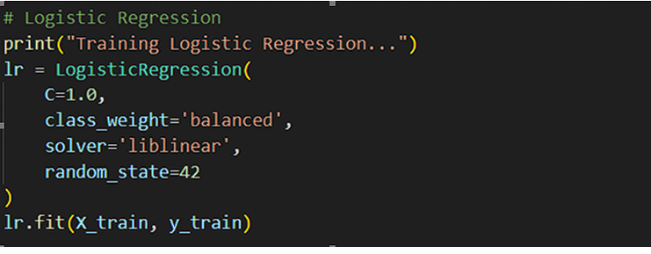
4.1 Machine Learning Techniques applied
To effectively classify whether a person has Parkinson’s Disease based on their vocal features, this project employed three popular supervised machine learning algorithms, each with its own approach to learning patterns in the data:
1. Logistic Regression
To establish a reliable baseline, we used Logistic Regression. Despite being a linear model, it gave us a strong benchmark for performance. Surprisingly, it achieved the highest AUC score (0.7025) in our evaluations, showing its effectiveness in separating profitable and unprofitable IPOs.

Slide 13
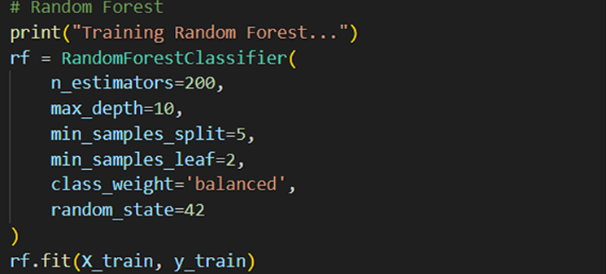
4.1 Machine Learning Techniques applied
2. Random Forest
We used Random Forest for its ability to handle non-linear relationships and its robustness against overfitting. As an ensemble of decision trees, it provided high accuracy and interpretability by evaluating feature importance. It performed consistently well across various experiments.

Slide 14
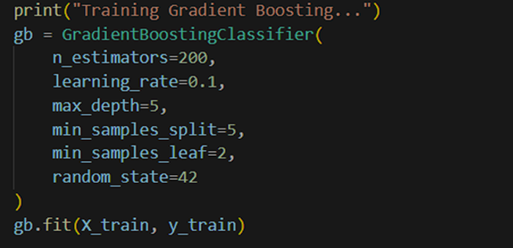
4.1 Machine Learning Techniques applied
3. Gradient Boosting
We included Gradient Boosting to capture incremental learning patterns. This technique builds models sequentially, with each new model correcting errors from the previous one. Although more sensitive to overfitting, it helped us improve performance on smaller nuances in the data.

Slide 15
4.1 Machine Learning Techniques applied
3. Gradient Boosting
We included Gradient Boosting to capture incremental learning patterns. This technique builds models sequentially, with each new model correcting errors from the previous one. Although more sensitive to overfitting, it helped us improve performance on smaller nuances in the data.

Slide 16
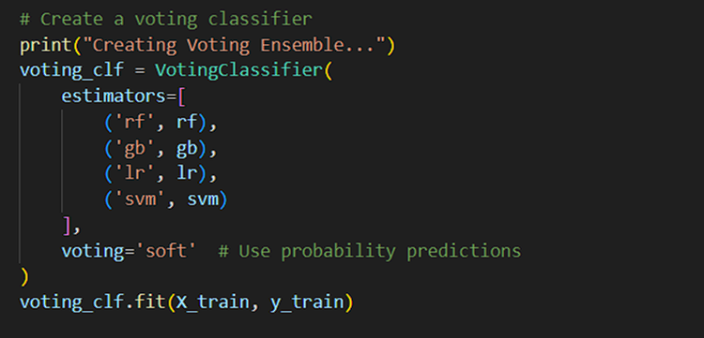
4.1 Machine Learning Techniques applied
5. Voting Ensemble
We combined multiple models using a Voting Classifier to take advantage of the strengths of each. By aggregating predictions, the ensemble provided better generalization than individual models and smoothed out inconsistencies.

Slide 17

5.1 Results obtained:
After training and evaluating multiple machine learning models, we obtained insightful results that validated our approach. Among all models tested, Logistic Regression performed the best in terms of AUC (0.7025), followed by Random Forest (AUC 0.6837). Other models like SVM, Gradient Boosting, and the Voting Classifier also showed competitive performance.
Our Neural Network model achieved a training accuracy of 85%, but the validation accuracy plateaued around 74%, indicating some overfitting. Despite that, it maintained a strong AUC (~0.9), showing it could distinguish between classes effectively.
We further evaluated the models using confusion matrices, classification reports, and ROC curves. The optimal threshold was identified around 0.5, where both precision and recall were balanced.
In our prototype test, the system predicted the IPO of MRF to be profitable with a listing gain of 31.24%, a predicted opening price of ₹59.06, and a 72% confidence from the ensemble model. Based on these insights, the system gave a Moderate BUY recommendation.

Slide 18
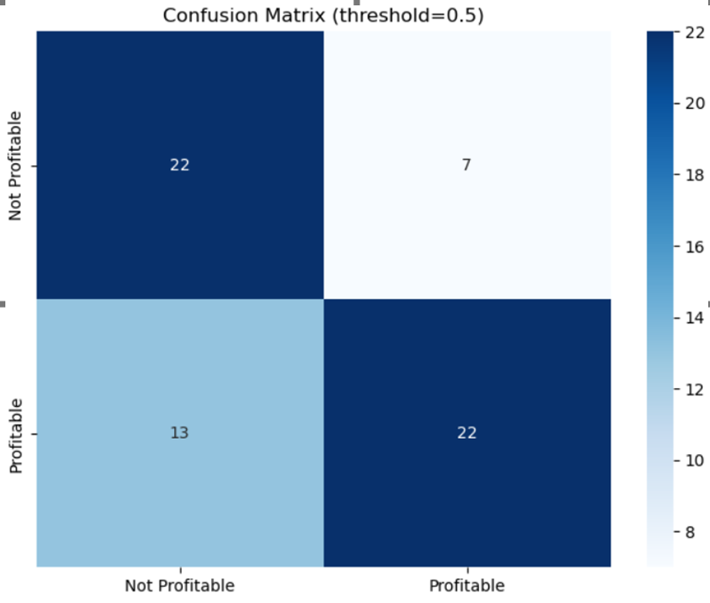
Confusion Matrix
The confusion matrix shows 22 correct predictions each for both profitable and not profitable cases. There are 7 false positives and 13 false negatives. The model performs reasonably but struggles more with identifying profitable instances, as indicated by the higher number of false negatives compared to false positives.

Slide 19

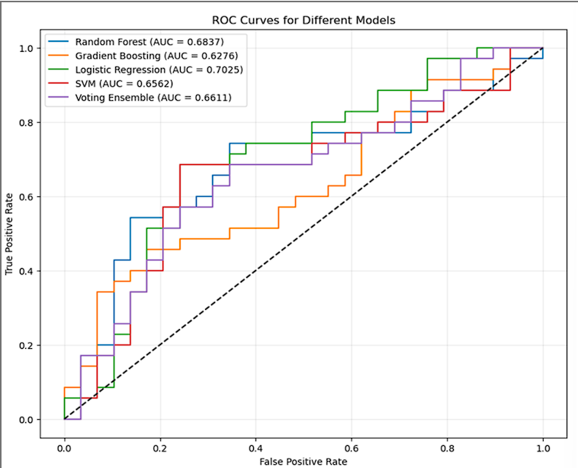
ROC CURVE—
This ROC (Receiver Operating Characteristic) curve compares the performance of five classification models: Random Forest, Gradient Boosting, Logistic Regression, SVM, and a Voting Ensemble. The ROC curve plots the True Positive Rate (TPR) against the False Positive Rate (FPR) at various threshold levels. A model with a curve closer to the top-left corner performs better, as it achieves higher TPR while maintaining low FPR.
The AUC (Area Under Curve) values indicate overall model performance:
Logistic Regression performs the best with an AUC of 0.7025.
Random Forest follows with an AUC of 0.6837.
Other models—SVM (0.6562), Voting Ensemble (0.6611), and Gradient Boosting (0.6276)—show slightly lower performance.

Slide 20

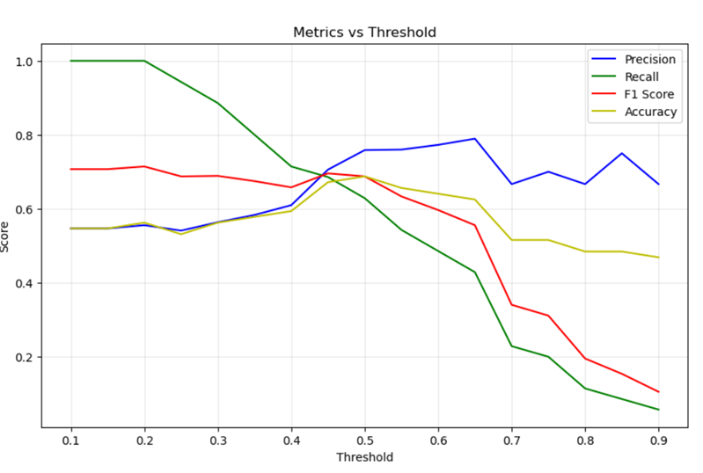
Metrics vs Threshold graph—
The graph shows how model metrics vary with threshold. As the threshold increases, precision rises while recall drops sharply. F1-score and accuracy peak around 0.5, indicating it as the optimal threshold. Beyond this, recall deteriorates rapidly, reducing overall model performance despite increased precision.

Slide 21

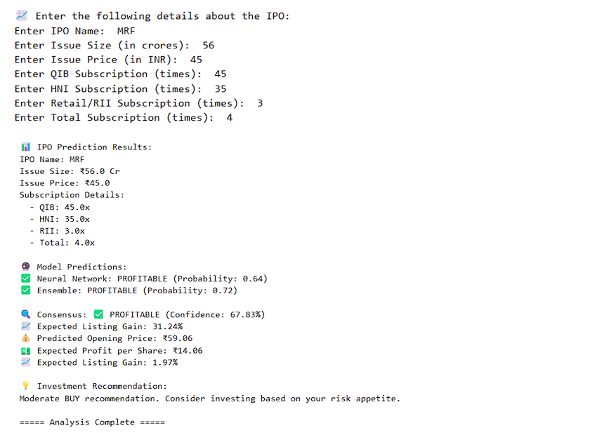
Final Output
This output displays IPO prediction results for MRF using machine learning models. The Neural Network (64% confidence) and Ensemble (72% confidence) both predict the IPO will be PROFITABLE, with an expected 31.24% listing gain and ₹59.06 opening price. The system recommends a Moderate BUY, suggesting investment based on risk tolerance.

Slide 22


6.1 Conclusion:
This project aims to fill the gap in IPO price prediction by creating a machine learning-based application to help investors assess IPO profitability before market launch. By integrating historical IPO data, financial metrics, and sentiment analysis, the model offers a tailored solution that helps reduce the risks associated with IPO investments. It demonstrates the feasibility of using machine learning to analyze financial data and provides a valuable tool for navigating the unpredictable IPO landscape.

Slide 23

7.1 References
1-Fischer, T., & Krauss, C. (2018): Deep learning with long short-term memory networks for financial market predictions. European Journal of Operational Research, 270(2), 654–669.
2-Beatty, R. P., & Ritter, J. R. (1986): Investment banking, reputation, and the underpricing of initial public offerings. Journal of Financial Economics, 15(1-2), 213–232.
3-Huang, J., & Wang, L. (2018): Machine learning-based sentiment analysis for stock price prediction. Multimedia Tools and Applications, 77(18), 23335–23348.
4-Kim, H. Y., & Won, C. H. (2018): Forecasting the volatility of stock price index: A hybrid model integrating LSTM with multiple GARCH-type models. Expert Systems with Applications, 103, 25–37.

Slide 24


